Slide 1
Security
Security - protection from malicious attempts to steal or modify data.
  Database system level
    Authentication and authorization mechanisms to allow specific users access only to required data
    We concentrate on authorization in the rest of this chapter
  Operating system level
    Operating system super-users can do anything they want to the database! Good operating system level security is required.
  Network level: must use encryption to prevent
    Eavesdropping (unauthorized reading of messages)
    Masquerading (pretending to be an authorized user or sending messages supposedly from authorized users)

Slide 2
Security (Cont.)
  Physical level
    Physical access to computers allows destruction of data by intruders; traditional lock-and-key security is needed
    Computers must also be protected from floods, fire, etc.
      More in Chapter 17 (Recovery)
  Human level
    Users must be screened to ensure that an authorized users do not give access to intruders
    Users should be trained on password selection and secrecy

Slide 3
Authorization
Forms of authorization on parts of the database:
Read authorization - allows reading, but not modification of data.
Insert authorization - allows insertion of new data, but not modification of existing data.
Update authorization - allows modification, but not deletion of data.
Delete authorization - allows deletion of data

Slide 4
Authorization (Cont.)
Forms of authorization to modify the database schema:
Index authorization - allows creation and deletion of indices.
Resources authorization - allows creation of new relations.
Alteration authorization - allows addition or deletion of attributes in a relation.
Drop authorization - allows deletion of relations.

Slide 5
Authorization and Views
Users can be given authorization on views, without being given any authorization on the relations used in the view definition
Ability of views to hide data serves both to simplify usage of the system and to enhance security by allowing users access only to data they need for their job
A combination or relational-level security and view-level security can be used to limit a user’s access to precisely the data that user needs.

Slide 6
View Example
Suppose a bank clerk needs to know the names of the customers of each branch, but is not authorized to see specific loan information.
  Approach: Deny direct access to the loan relation, but grant access to the view cust-loan, which consists only of the names of customers and the branches at which they have a loan.
  The cust-loan view is defined in SQL as follows:
create view cust-loan as
select branchname, customer-name
from borrower, loan
where borrower.loan-number = loan.loan-number

Slide 7
View Example (Cont.)
The clerk is authorized to see the result of the query:
        select *
        from cust-loan
When the query processor translates the result into a query on the actual relations in the database, we obtain a query on borrower and loan.
Authorization must be checked on the clerk’s query before query processing begins.

Slide 8
Authorization on Views
Creation of view does not require resources authorization since no real relation is being created
The creator of a view gets only those privileges that provide no additional authorization beyond that he already had.
E.g. if creator of view cust-loan had only read authorization on borrower and loan, he gets only read authorization on cust-loan

Slide 9
Granting of Privileges
The passage of authorization from one user to another may be represented by an authorization graph.
The nodes of this graph are the users.
The root of the graph is the database administrator.
Consider graph for update authorization on loan.
An edge U_{i} →U_{j} indicates that user U_{i} has granted update authorization on loan to U_{j.}
U₁
U₄
DBA
U₂
U₅
U₃

Slide 10
Authorization Grant Graph
Requirement: All edges in an authorization graph must be part of some path originating with the database administrator
If DBA revokes grant from U₁:
  Grant must be revoked from U₄ since U₁ no longer has authorization
  Grant must not be revoked from U₅ since U₅ has another authorization path from DBA through U₂
Must prevent cycles of grants with no path from the root:
  DBA grants authorization to U₇
  U7 grants authorization to U₈
  U8 grants authorization to U₇
  DBA revokes authorization from U₇
Must revoke grant U₇ to U₈ and from U₈ to U₇ since there is no path from DBA to U₇ or to U₈ anymore.

Slide 11
Security Specification in SQL
The grant statement is used to confer authorization
grant <privilege list>
on <relation name or view name> to <user list>
<user list> is:
  a user-id
  public, which allows all valid users the privilege granted
  A role (more on this later)
Granting a privilege on a view does not imply granting any privileges on the underlying relations.
The grantor of the privilege must already hold the privilege on the specified item (or be the database administrator).

Slide 12
Privileges in SQL
select: allows read access to relation,or the ability to query using the view
  Example: grant users U₁, U₂, and U₃ select authorization on the branch relation:
grant select on branch to U₁, U₂, U₃
insert: the ability to insert tuples
update: the ability to update using the SQL update statement
delete: the ability to delete tuples.
references: ability to declare foreign keys when creating relations.
usage: In SQL-92; authorizes a user to use a specified domain
all privileges: used as a short form for all the allowable privileges

Slide 13
Privilege To Grant Privileges
with grant option: allows a user who is granted a privilege to pass the privilege on to other users.
  Example:
      grant select on branch to U₁ with grant option
    gives U₁ the select privileges on branch and allows U₁ to grant this
    privilege to others

Slide 14
Roles
Roles permit common privileges for a class of users can be specified just once by creating a corresponding “role”
Privileges can be granted to or revoked from roles, just like user
Roles can be assigned to users, and even to other roles
SQL:1999 supports roles
      create role teller
      create role manager
      grant select on branch to teller
      grant update (balance) on account to teller
      grant all privileges on account to manager
      grant teller to manager
      grant teller to alice, bob
      grant manager to avi

Slide 15
Revoking Authorization in SQL
The revoke statement is used to revoke authorization.
  revoke<privilege list>
  on <relation name or view name> from <user list> [restrict|cascade]
Example:
  revoke select on branch from U₁, U₂, U₃ cascade
Revocation of a privilege from a user may cause other users also to lose that privilege; referred to as cascading of the revoke.
We can prevent cascading by specifying restrict:
  revoke select on branch from U₁, U₂, U₃ restrict
With restrict, the revoke command fails if cascading revokes are required.

Slide 16
Revoking Authorization in SQL (Cont.)
<privilege-list> may be all to revoke all privileges the revokee may hold.
If <revokee-list> includes public all users lose the privilege except those granted it explicitly.
If the same privilege was granted twice to the same user by different grantees, the user may retain the privilege after the revocation.
All privileges that depend on the privilege being revoked are also revoked.

Slide 17
Limitations of SQL Authorization
SQL does not support authorization at a tuple level
  E.g. we cannot restrict students to see only (the tuples storing) their own grades
All end-users of an application (such as a web application) may be mapped to a single database user
The task of authorization in above cases falls on the application program, with no support from SQL
  Authorization must be done in application code, and may be dispersed all over an application
  Checking for absence of authorization loopholes becomes very difficult since it requires reading large amounts of application code

Slide 18
Encryption
Data may be encrypted when database authorization provisions do not offer sufficient protection.
Properties of good encryption technique:
  Relatively simple for authorized users to encrypt and decrypt data.
  Encryption scheme depends not on the secrecy of the algorithm but on the secrecy of a parameter of the algorithm called the encryption key.
  Extremely difficult for an intruder to determine the encryption key.

Slide 19
Encryption (Cont.)
Data Encryption Standard (DES) substitutes characters and rearranges their order on the basis of an encryption key which is provided to authorized users via a secure mechanism. Scheme is no more secure than the key transmission mechanism since the key has to be shared.
Advanced Encryption Standard (AES) is a new standard replacing DES, and is based on the Rijndael algorithm, but is also dependent on shared secret keys
Public-key encryption is based on each user having two keys:
  public key – publicly published key used to encrypt data, but cannot be used to decrypt data
  private key -- key known only to individual user, and used to decrypt data.
  Need not be transmitted to the site doing encryption.
Encryption scheme is such that it is impossible or extremely hard to decrypt data given only the public key.
The RSA public-key encryption scheme is based on the hardness of factoring a very large number (100's of digits) into its prime components.

Slide 20
Authentication
Password based authentication is widely used, but is susceptible to sniffing on a network
Challenge-response systems avoid transmission of passwords
  DB sends a (randomly generated) challenge string to user
  User encrypts string and returns result.
  DB verifies identity by decrypting result
  Can use public-key encryption system by DB sending a message encrypted using user’s public key, and user decrypting and sending the message back
Digital signatures are used to verify authenticity of data
  E.g. use private key (in reverse) to encrypt data, and anyone can verify authenticity by using public key (in reverse) to decrypt data. Only holder of private key could have created the encrypted data.
  Digital signatures also help ensure nonrepudiation: sender
  cannot later claim to have not created the data

Slide 21
Statistical Databases
Problem: how to ensure privacy of individuals while allowing use of data for statistical purposes (e.g., finding median income, average bank balance etc.)
Solutions:
  System rejects any query that involves fewer than some predetermined number of individuals.
  ∗ Still possible to use results of multiple overlapping queries to deduce data about an individual
  Data pollution -- random falsification of data provided in response to a query.
  Random modification of the query itself.
There is a tradeoff between accuracy and security.

Slide 22
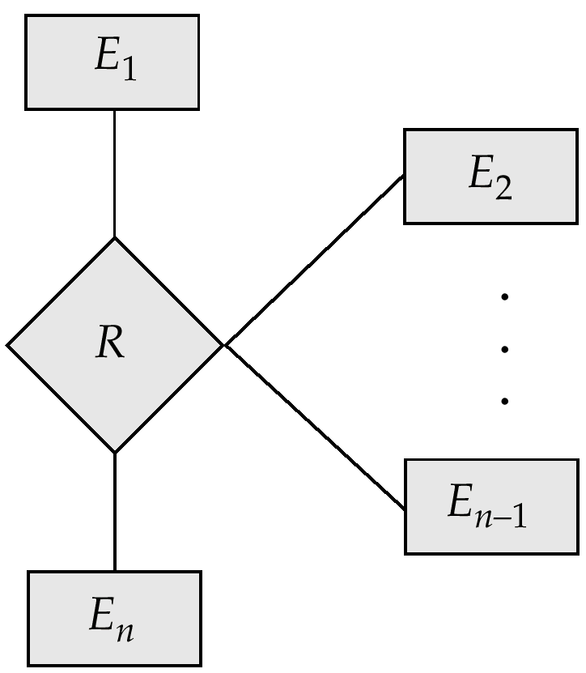
An n-ary Relationship Set

Slide 23
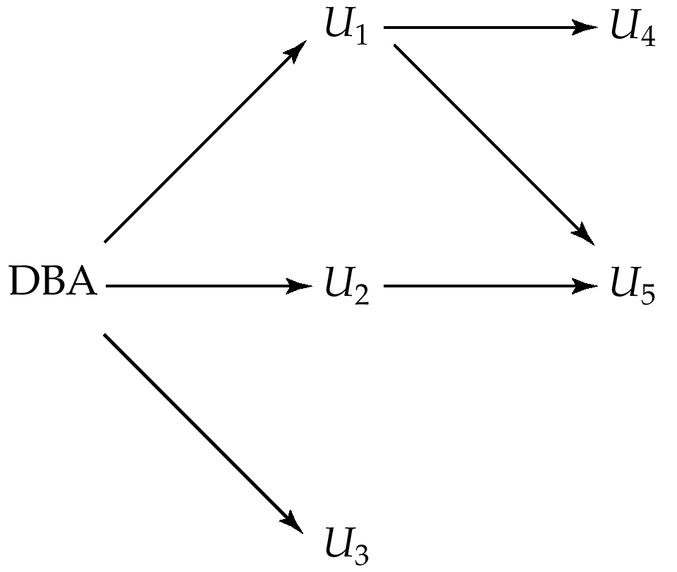
Authorization-Grant Graph

Slide 24
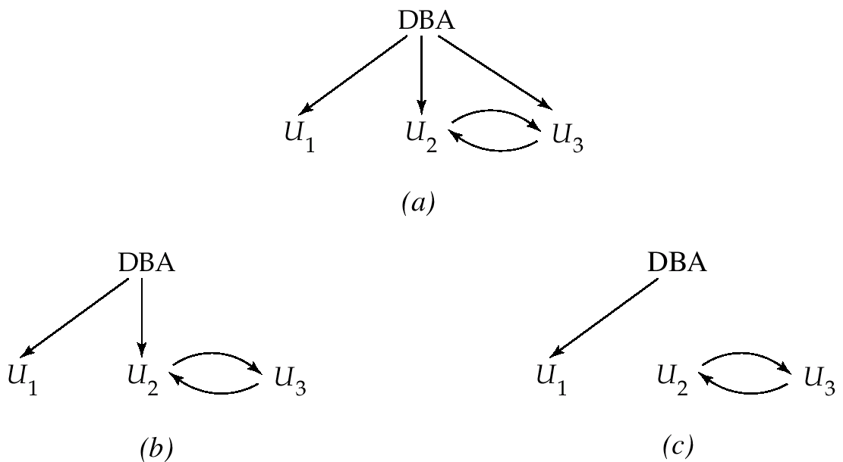
Attempt to Defeat Authorization Revocation

Slide 25
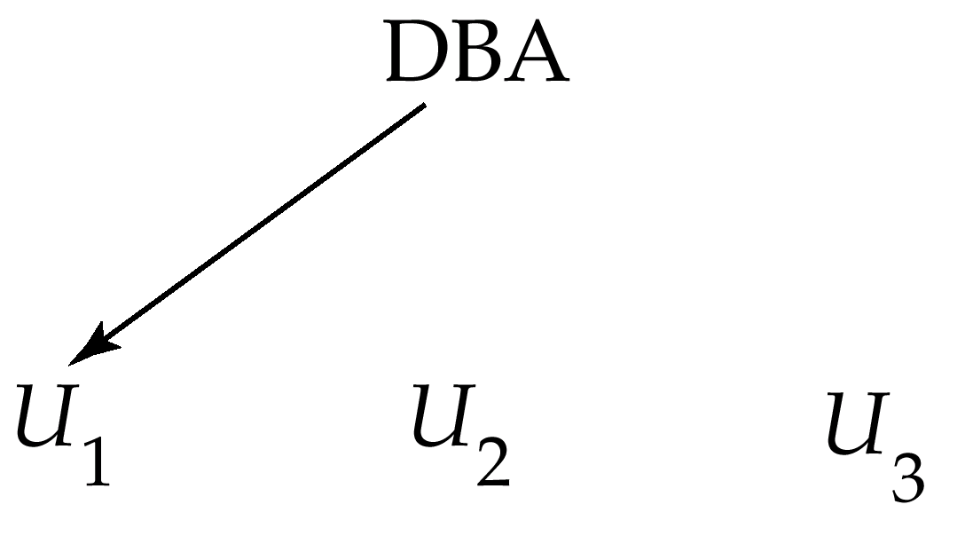
Authorization Graph

Slide 26
Physical Level Security
Protection of equipment from floods, power failure, etc.
Protection of disks from theft, erasure, physical damage, etc.
Protection of network and terminal cables from wiretaps non-invasive electronic eavesdropping, physical damage, etc.
Solutions:
Replicated hardware:
  mirrored disks, dual busses, etc.
  multiple access paths between every pair of devises
Physical security: locks,police, etc.
Software techniques to detect physical security breaches.

Slide 27
Human Level Security
Protection from stolen passwords, sabotage, etc.
Primarily a management problem:
  Frequent change of passwords
  Use of “non-guessable” passwords
  Log all invalid access attempts
  Data audits
  Careful hiring practices

Slide 28
Operating System Level Security
Protection from invalid logins
File-level access protection (often not very helpful for database security)
Protection from improper use of “superuser” authority.
Protection from improper use of privileged machine intructions.

Slide 29
Network-Level Security
Each site must ensure that it communicate with trusted sites (not intruders).
Links must be protected from theft or modification of messages
Mechanisms:
  Identification protocol (password-based),
  Cryptography.

Slide 30
Database-Level Security
Assume security at network, operating system, human, and physical levels.
Database specific issues:
  each user may have authority to read only part of the data and to write only part of the data.
  User authority may correspond to entire files or relations, but it may also correspond only to parts of files or relations.
Local autonomy suggests site-level authorization control in a distributed database.
Global control suggests centralized control.

